Slide 1
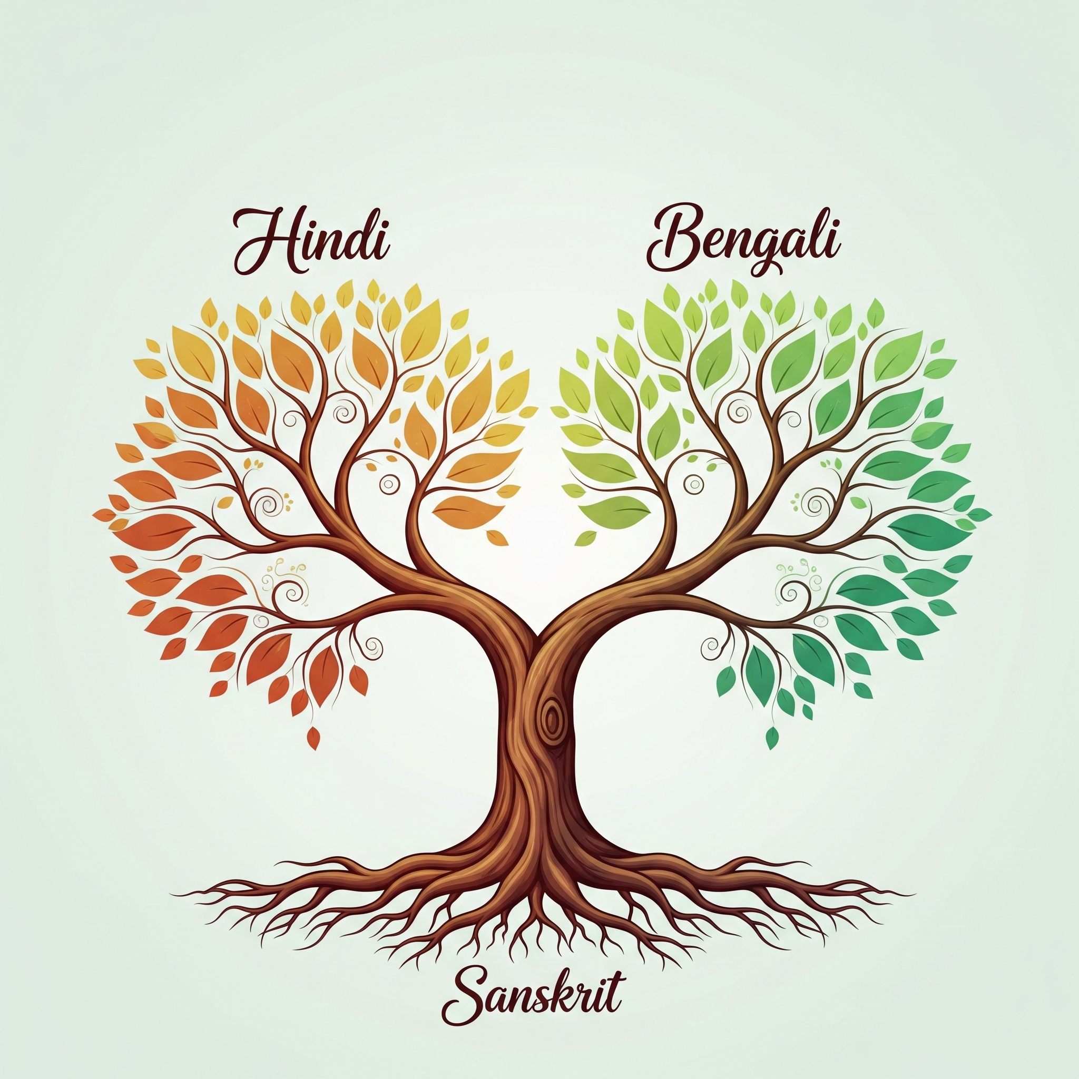
Hindi, Bengali & Sanskrit: A Linguistic Journey Through Time
Trina Dey
FEIT Festival of Languages
20 Feb 2026

Slide 2
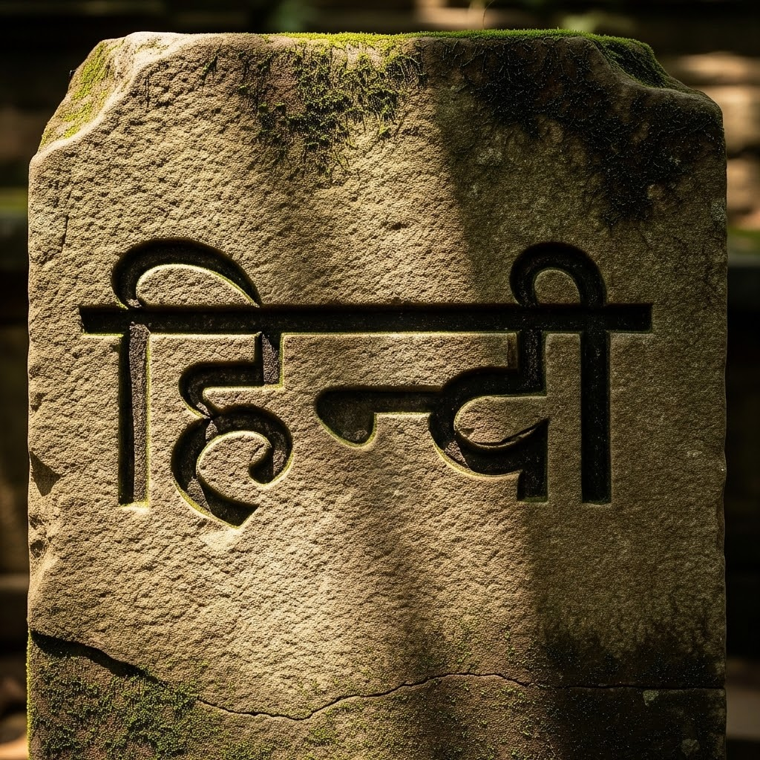
Hindi: The Official Language
Hindi is one of the official language of India
Primarily spoken across North and Central India
It is written using the Devanagari script.
491 million people speaks Hindi [Bhumika et. al, 2025] as their first language and approx. 600 million people speak Hindi worldwide.

Slide 3
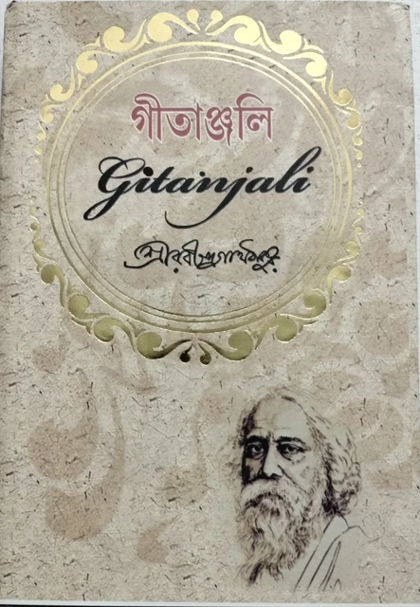
Bengali: Rich Literary Language
Official language of Bangladesh and West Bengal, India
The language is written in the distinct Bangla script
Developed from Magadhi Prakrit and Apabhramsha
Spoken by over 280 million people worldwide
Strong literary presence - Rabindranath Tagore won nobel prize in literature in 1913 for book of poems named Gitanjali.

Slide 4
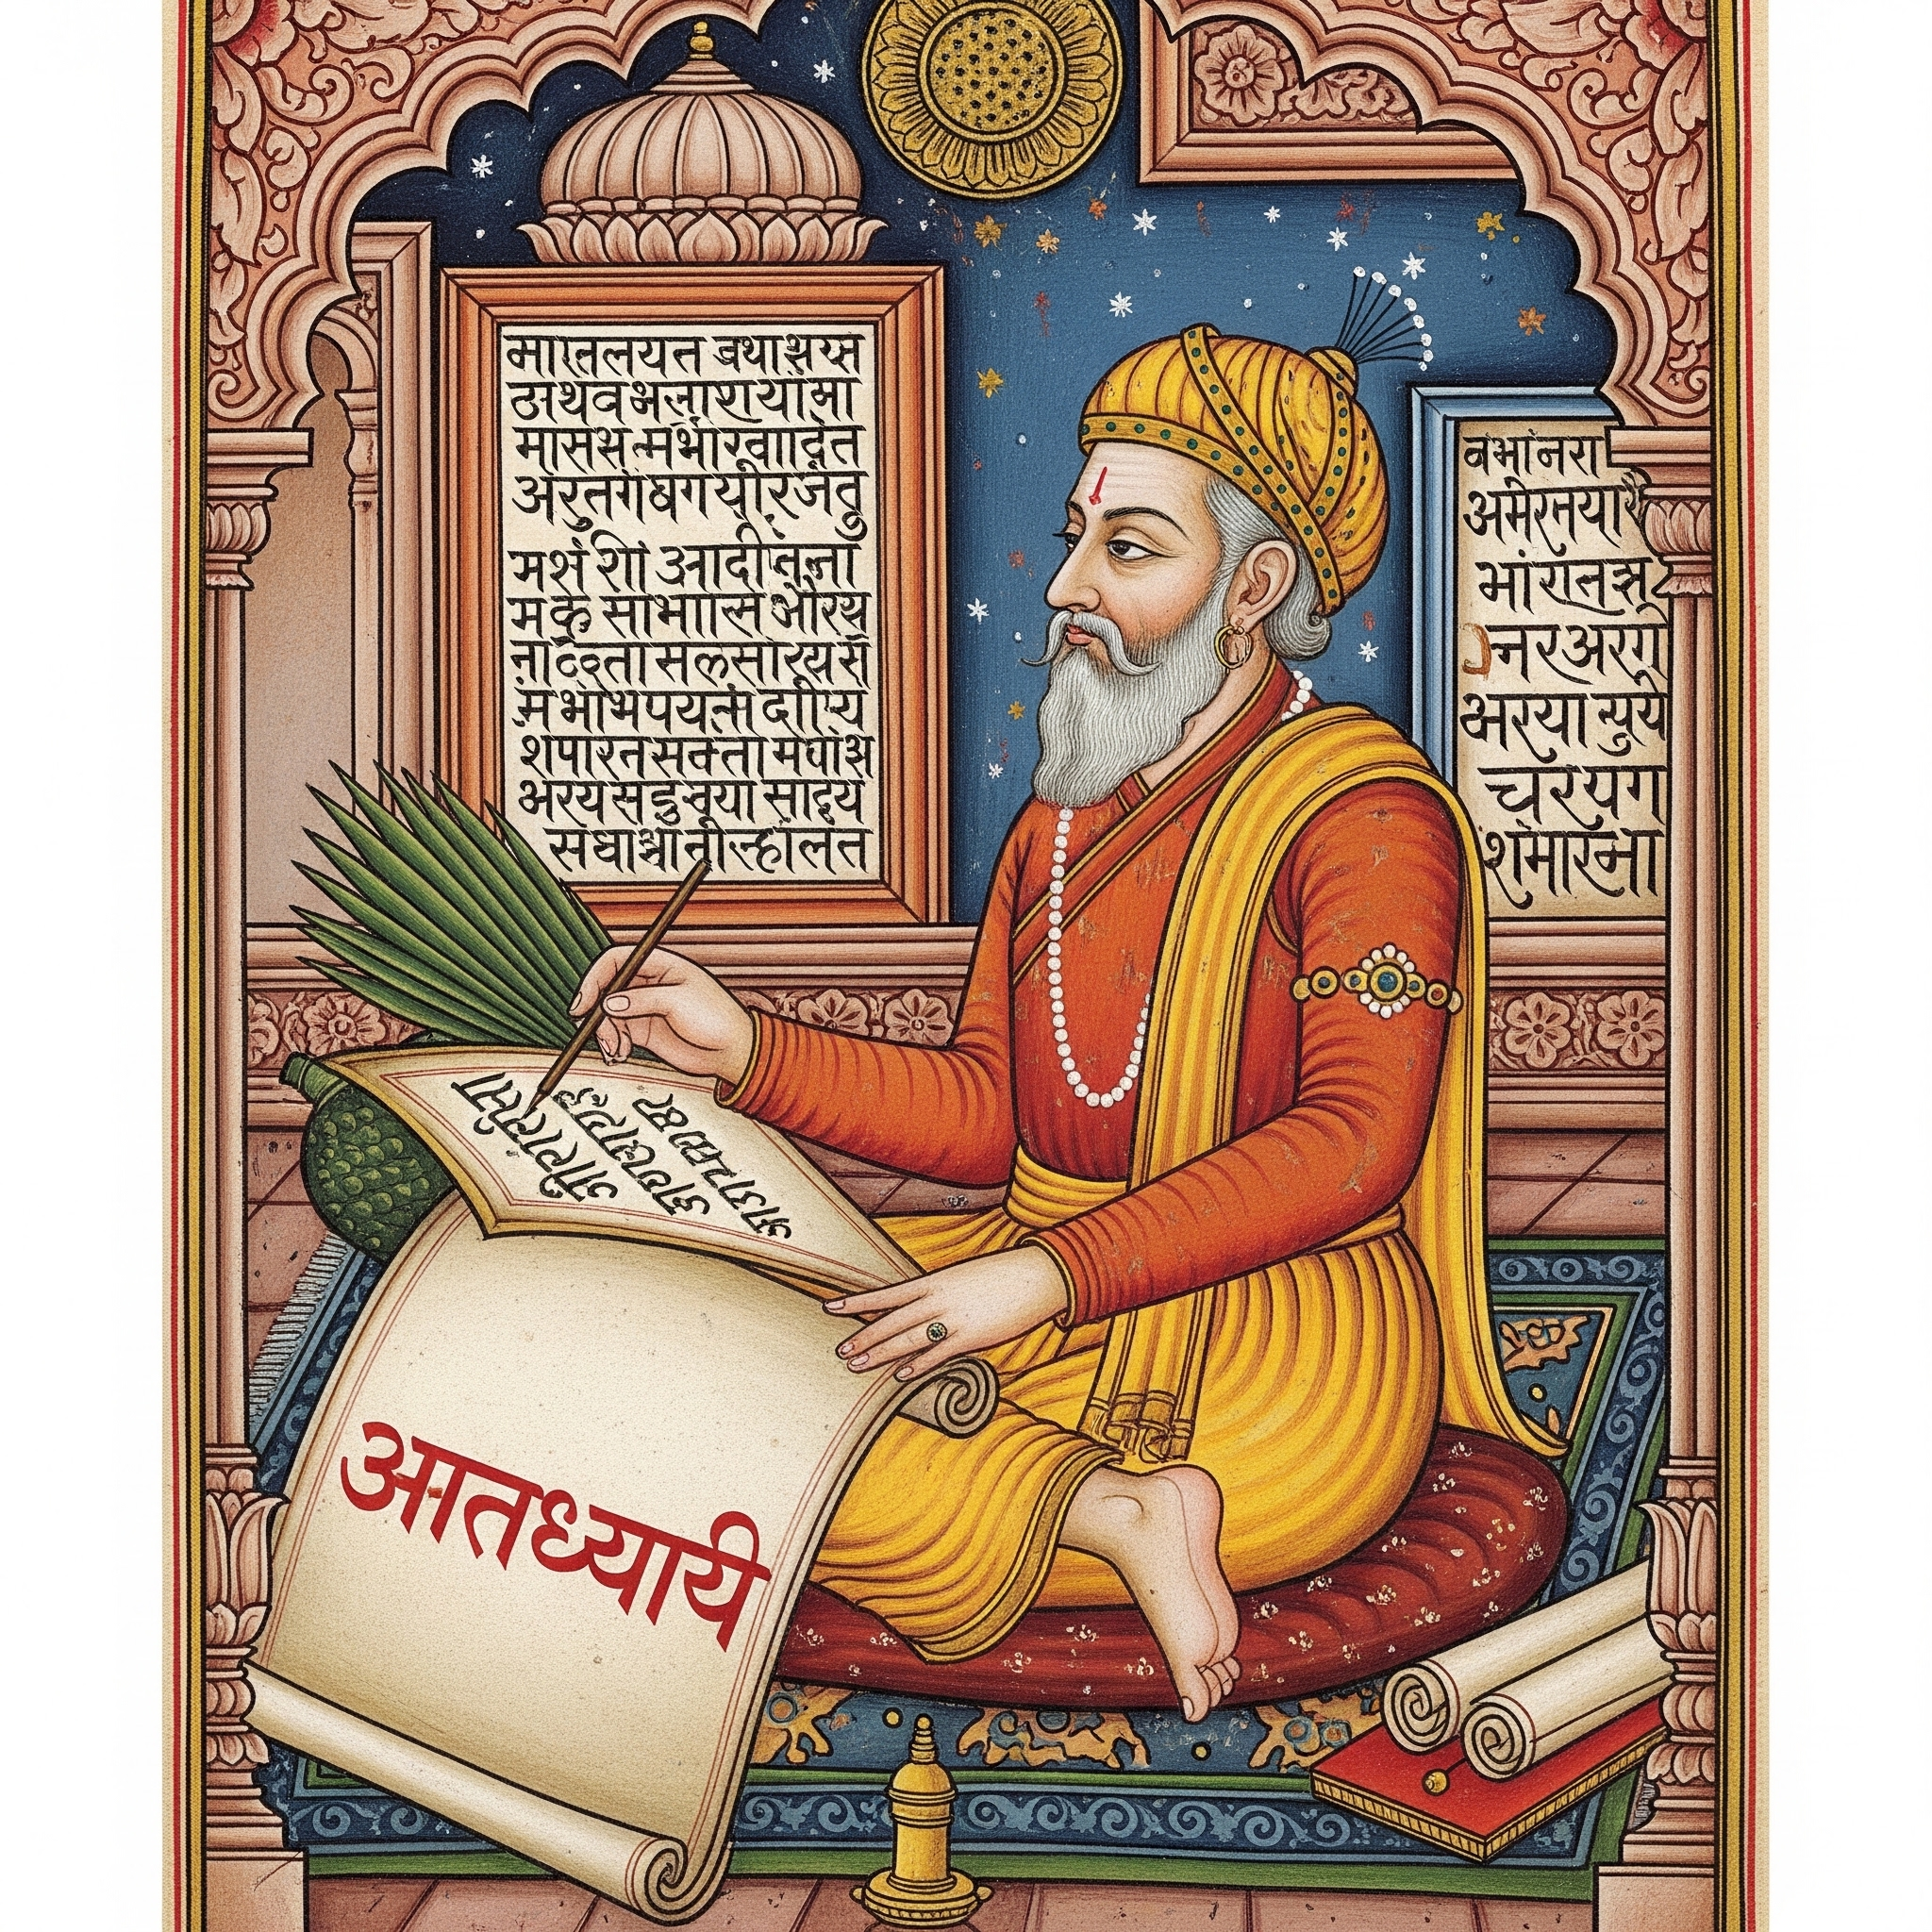
Sanskrit: Origins and Impact
Ancient classical language first used in the Rigveda
Panini systematized grammar in the Ashtadhyayi around 500 B.C.
Belongs to the Indo-Aryan (Indo-European) language family
Pali and Prakrit were the two original branches of Sanskrit which later branched out to Paishachi, Shourseni, Magadhi, Ardha-Magadhi, Maharahstri
Hindi was then evolved from Shaurseni Apabhramsha, whereas Bengali evolved from Magadhi

Slide 5
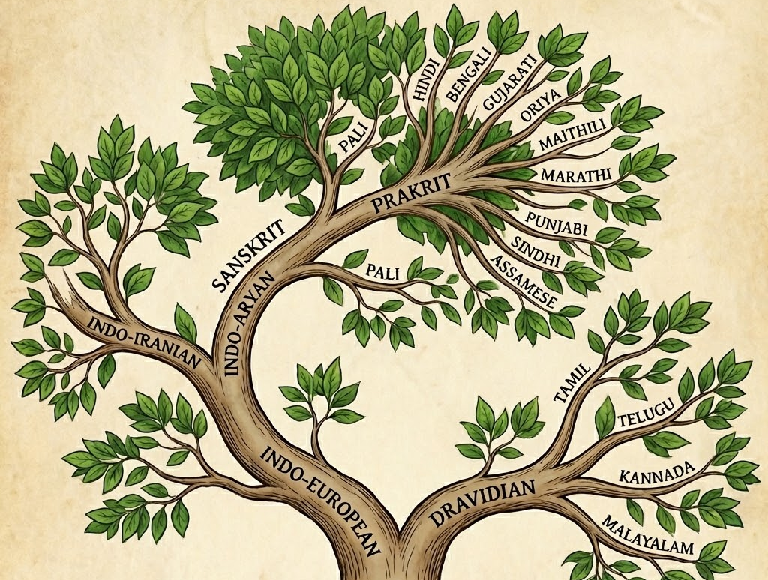
Language Tree for Indian Languages

Slide 6
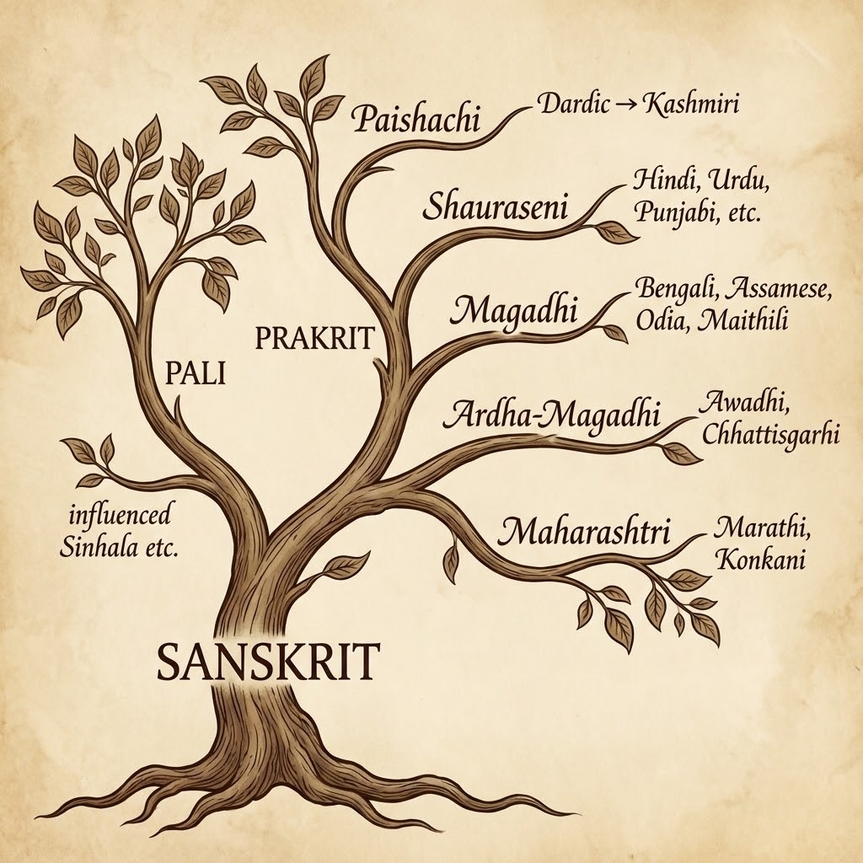
Evolution of languages from Sanskrit

Slide 7
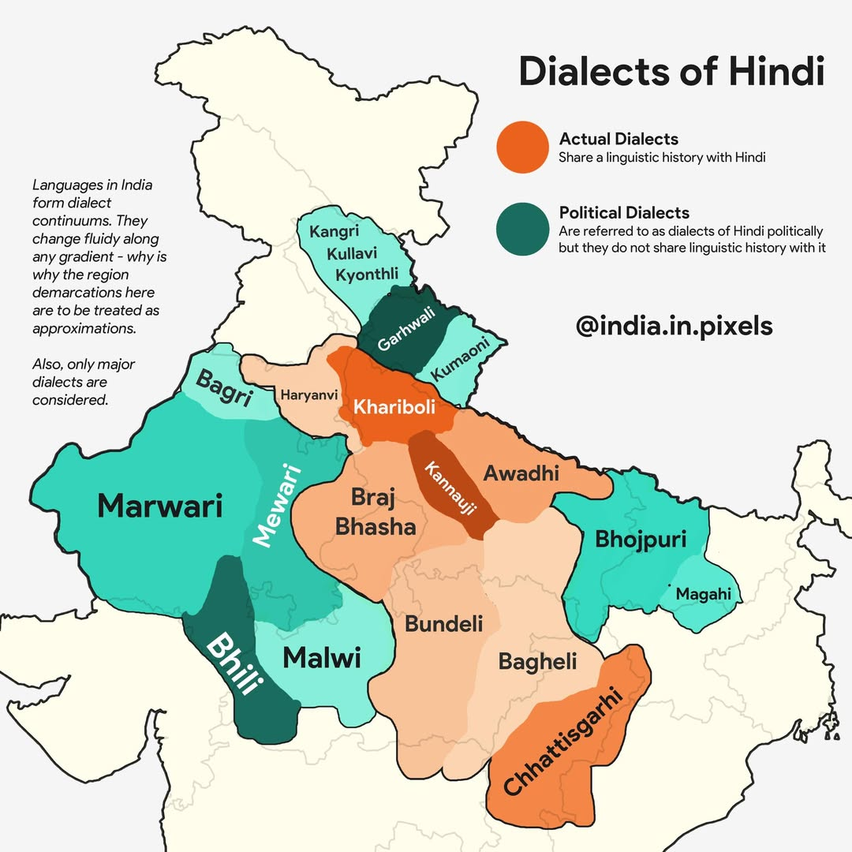
Colloquial Hindi
G.A. Grierson's classification (1883, 1969) divides the Hindi dialect continuum into subgroups:
Western Hindi (including Braj, Kannauji, and Haryanvi),
Eastern Hindi (comprising Awadhi, Bagheli, and Chhattisgarhi),
Bihari (covering Bhojpuri, Magahi, and Maithili),
Central Pahari (such as Kumauni and Garhwali), and
Rajasthani (including Marwari, Mewari, Harauti, and Malvi).

Slide 8
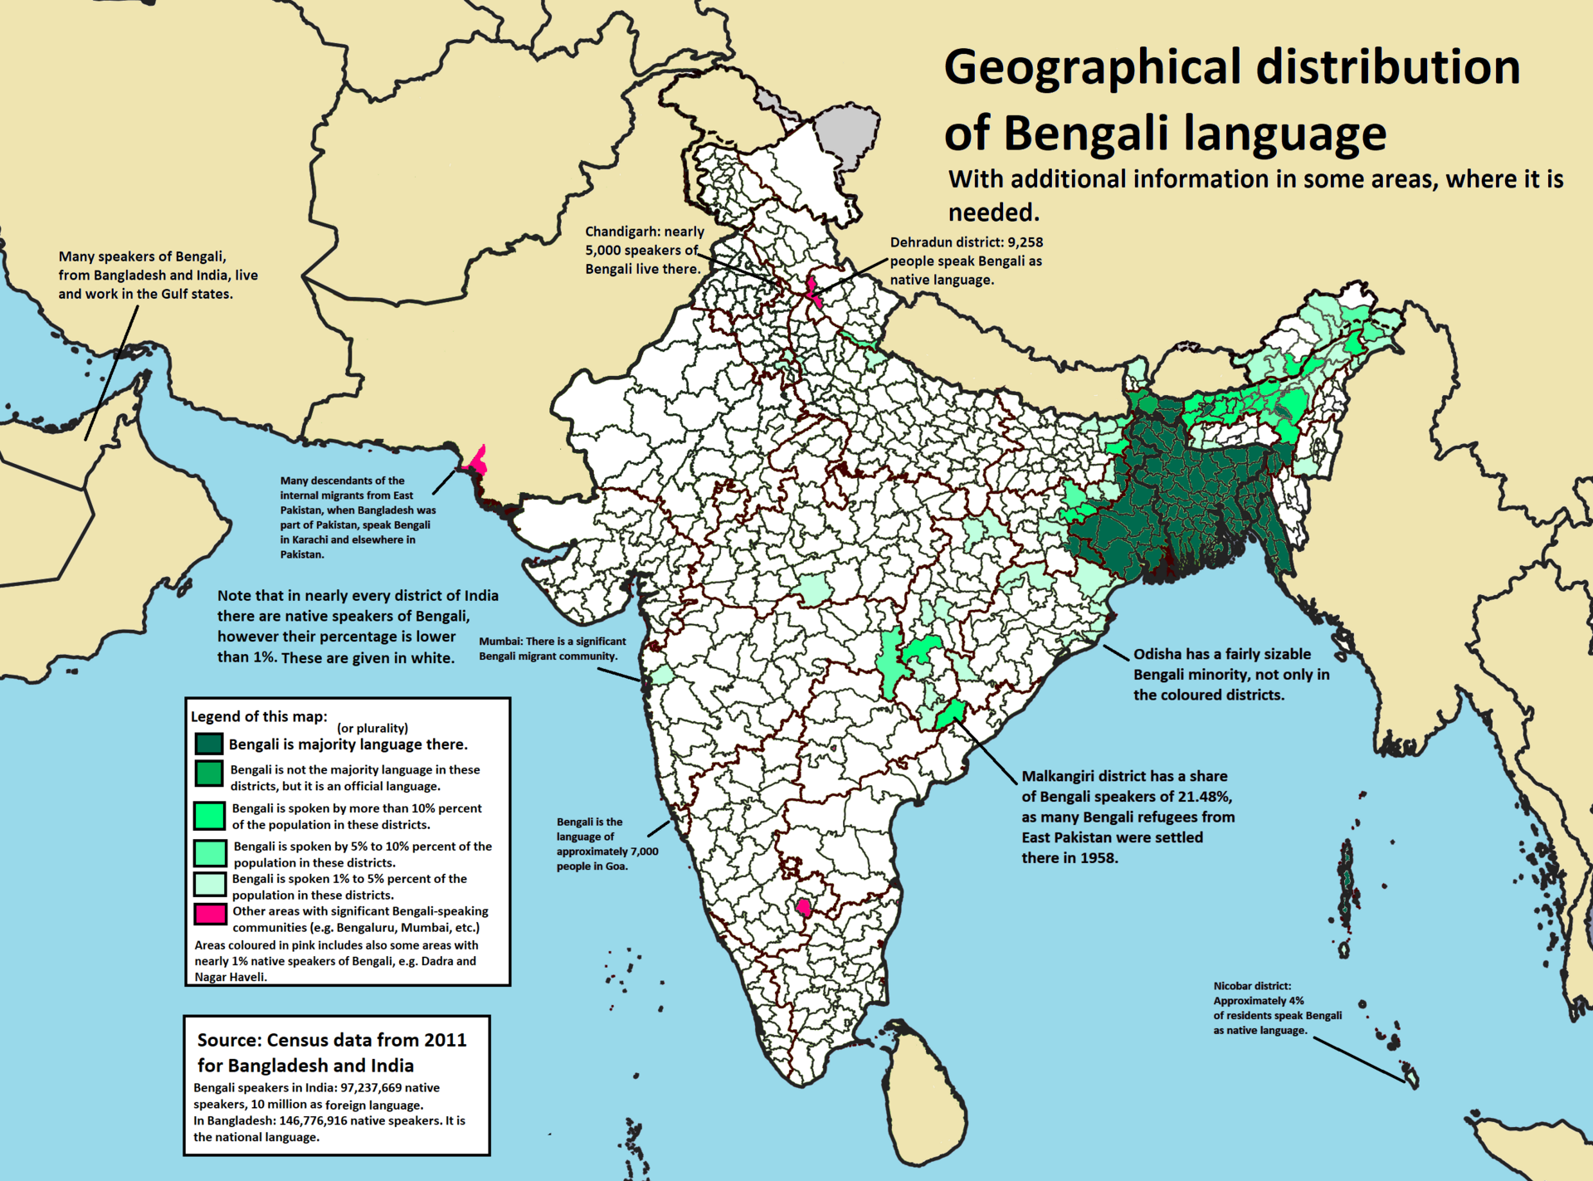
States speaking Bengali
Majorly Bengali is spoken in West Bengal and Bangladesh as primary language.
But there are other states that speaks small amount of Bengali
Assam
Tripura
Manipur
Parts of Jharkhand and Bihar
Orissa
Parts of Andaman and Nicobar Island
Interestingly Assamese, Bengali, Manipuri shares the same script however are spoken differently.

Slide 9
Shared words, distinct scripts
Example 1: Word for “Mother”
Sanskrit: Mātṛ (मातृ)
Hindi: Mā̃ (माँ)
Bengali: Mā (মা)
Example 2: Word for “Name”
Sanskrit: Nāma (नाम)
Hindi: Naam (नाम)
Bengali: Naam (নাম)
Example 3: Word for “Night”
Sanskrit: Rātri (रात्रि)
Hindi: Raat (रात)
Bengali: Raat (রাত)

Slide 10
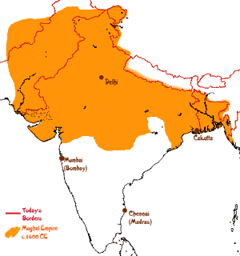
Why Languages Evolved
Languages evolve through phonetic simplification and regional separation
Cultural diversity and political changes influence language evolution
Invasions and foreign rule significantly impact language development
Mughal influence led to Persian becoming the court language (1526 – 1707 AD)
Hindi absorbed Persian and Arabic words due to Mughal rule
British influence (1608 – 1947) led to absorption of english words in Hindi (Bus, school, train)

Slide 11
Influences on language
Example 1: Word for “Book”
Sanskrit: Pustakam (पुस्तकम्)
Hindi: Kitab (किताब) (Persian origin)
Bengali: Boi (বই) (Influenced from Sanskrit Vahi)
Example 2: Word for “Friend”
Sanskrit: Mitra (मित्र)
Hindi: Dost (दोस्त) (Persian origin)
Bengali: Bondhu (বন্ধু) (Influenced from Sanskrit Vahi)
Example 3: Word for “Market”
Sanskrit: Vipani (विपणि)
Hindi: Bazaar (बाज़ार) (Persian origin)
Bengali: Bajar (বাজার) (Persian origin through trade routes)

Slide 12
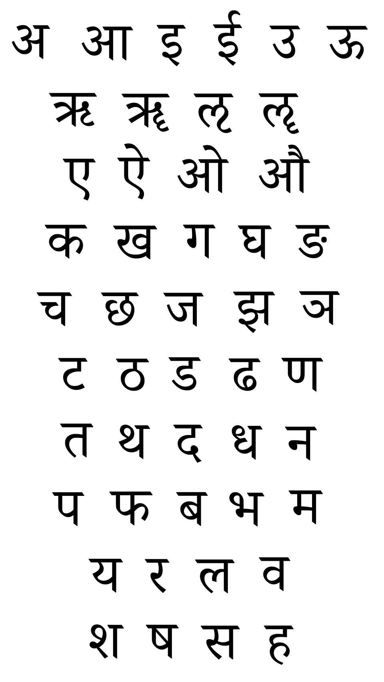
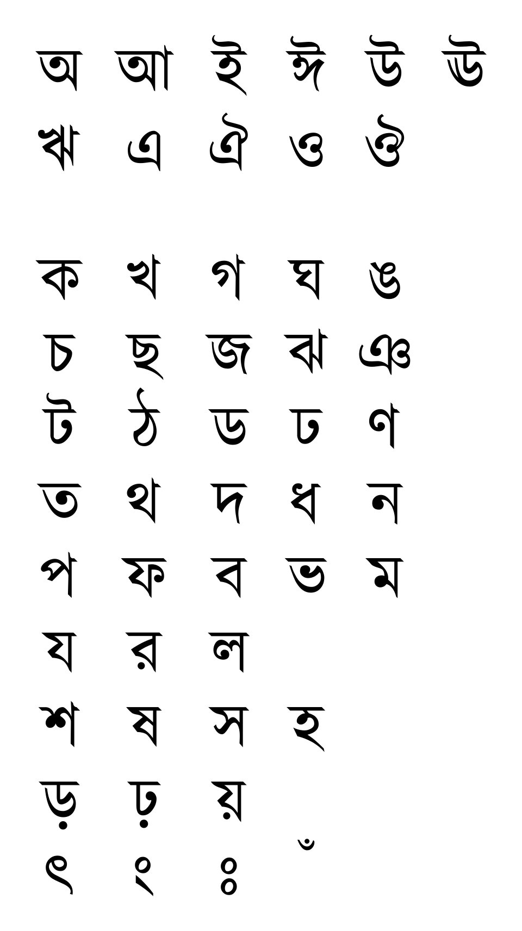
Scripts
Sanskrit and Hindi follows Devnagri Script
13 vowels
33 consonants
Bengali follows its own Bangla script
13 vowels
39 standard consonants
97 other symbols for compound letters.
Example – শ – sh and ন as n. but together they form স্ন
Another example - ক as K, ত as T but together they are ক্ত

Slide 13
References
Bhumika Patel and Dr. Shweta Gohel. Language Trees of India. International Journal of Research in Academic World. 2025; 4(4):130-135,
https://www.sanskrit.nic.in/about_sanskrit.php
https://pragyata.com/on-the-classification-of-indic-languages/
Census Data https://censusindia.gov.in/nada/index.php/catalog/42458/download/46089/C-16_25062018.pdf

Slide 14
Thank you

